Slide 1
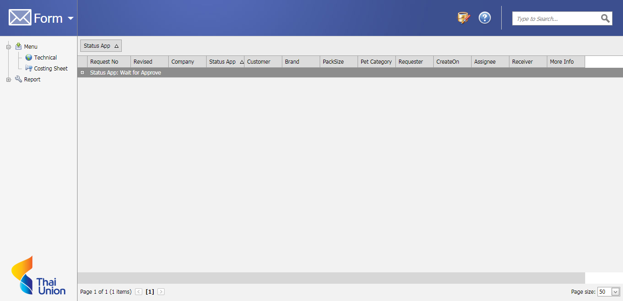
Costing Sheet Project
http://192.168.1.193/Webapi/Default.aspx
Or
http://tnrprd01/webapi/default.aspx

Slide 2
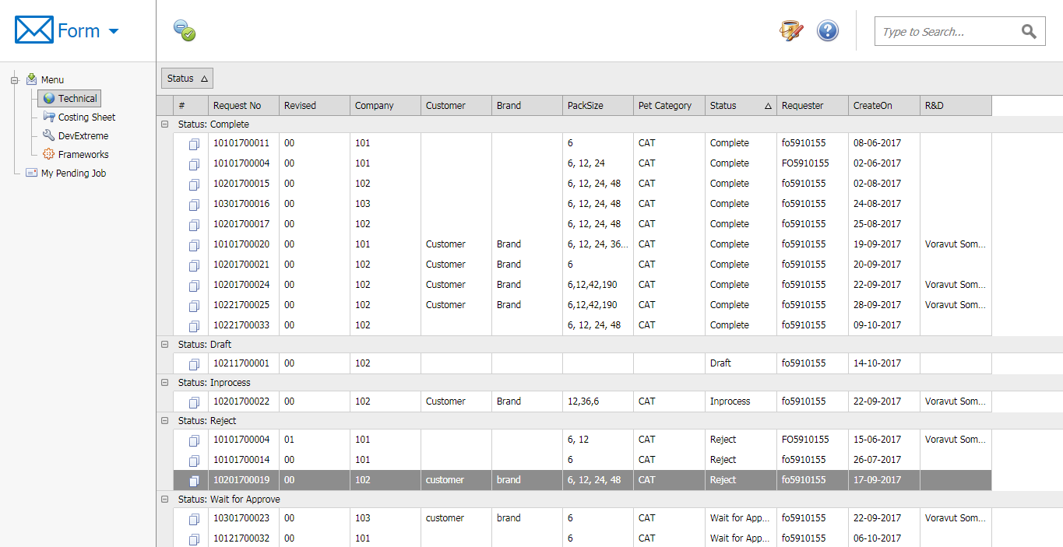
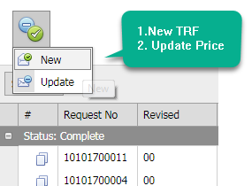
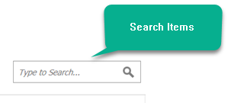
Create New TRF

Slide 3
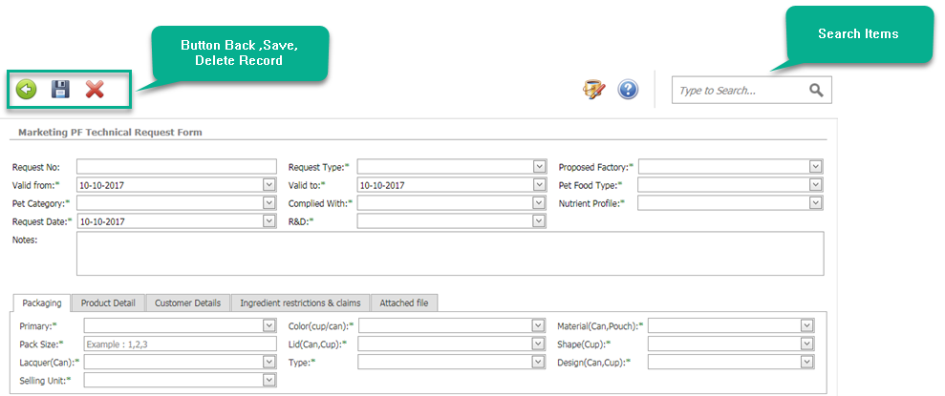
Create New TRF

Slide 4


Create New TRF
File upload process

Slide 5


Create New TRF

Slide 6
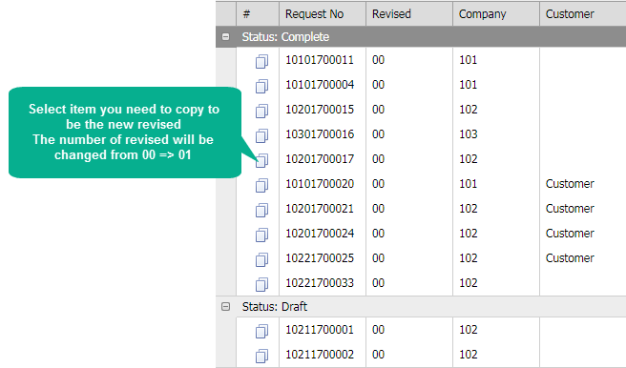
Copy TRF

Slide 7
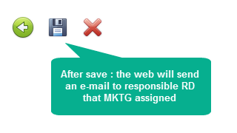
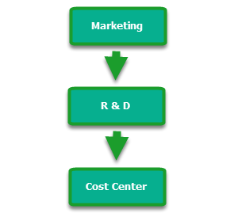
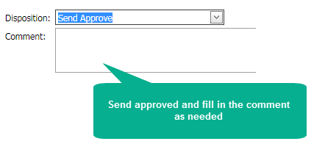

Step Approve TRF
Step Marketing
Step R&D ,Costing Center

Slide 8
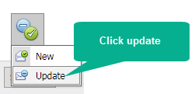
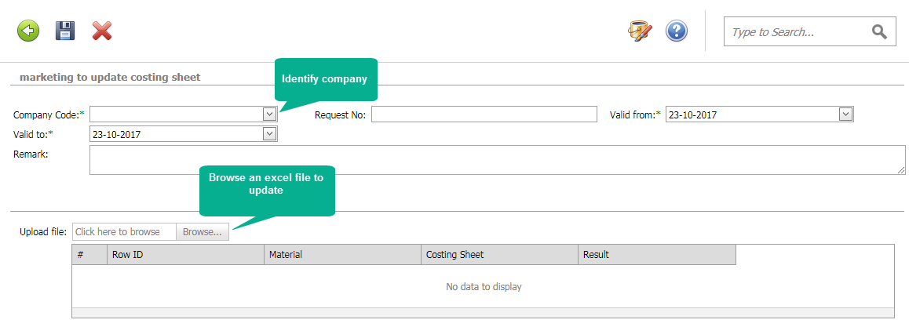
Update Price TRF

Slide 9
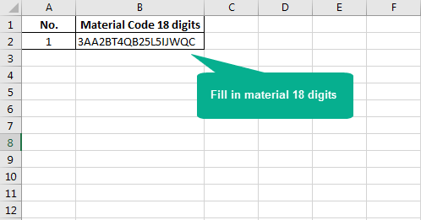
Update Price TRF

Slide 10

Update Price TRF

Slide 11
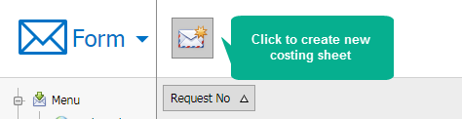
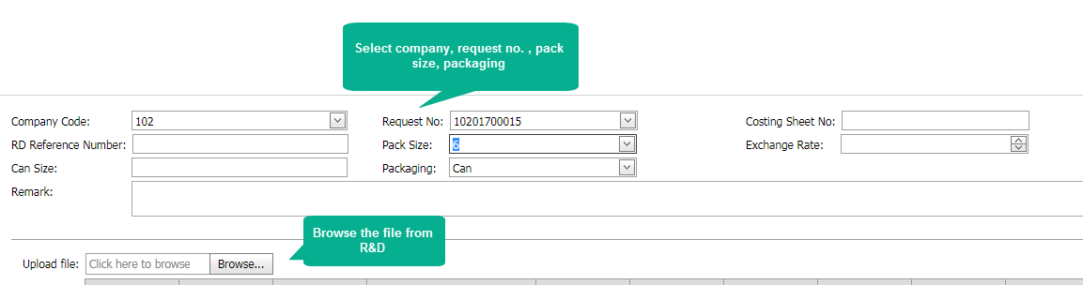
Create Costing Sheet

Slide 12
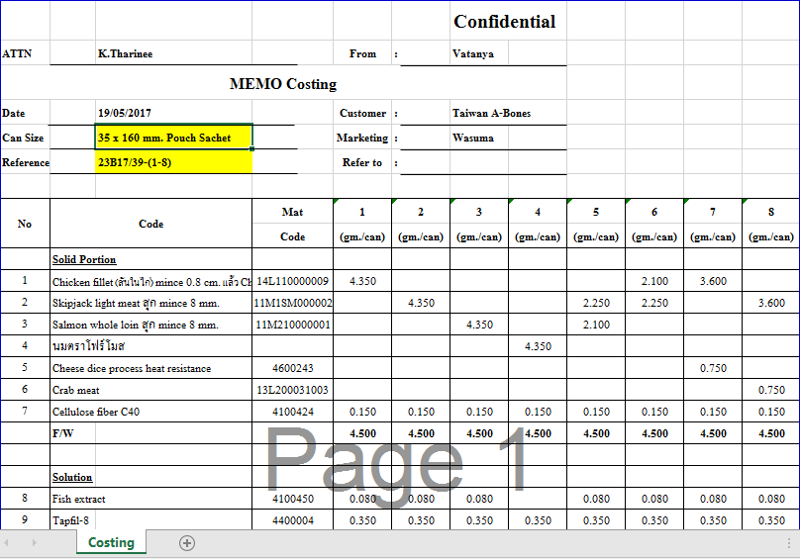
Create Costing Sheet

Slide 13

Create Costing Sheet

Slide 14
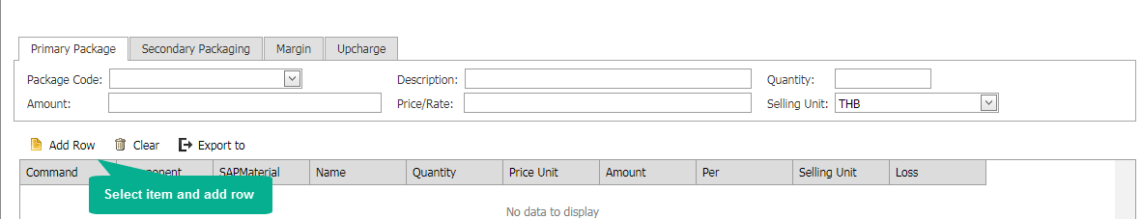

Create Costing Sheet

Slide 15
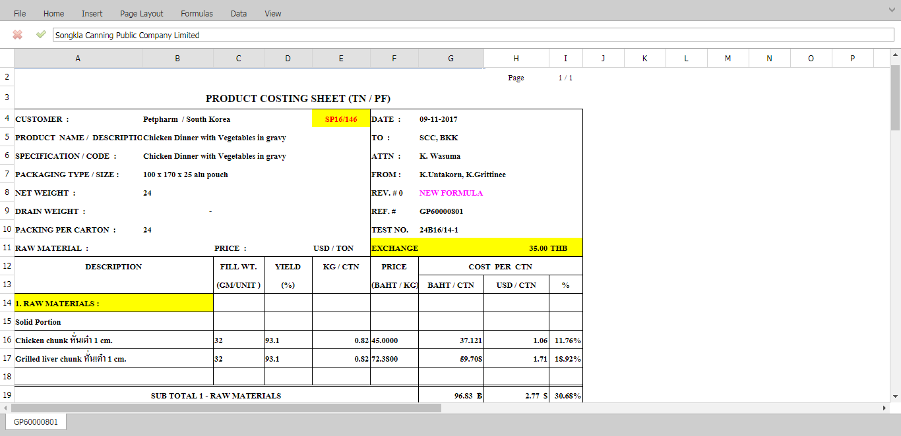
Create Costing Sheet

Slide 16
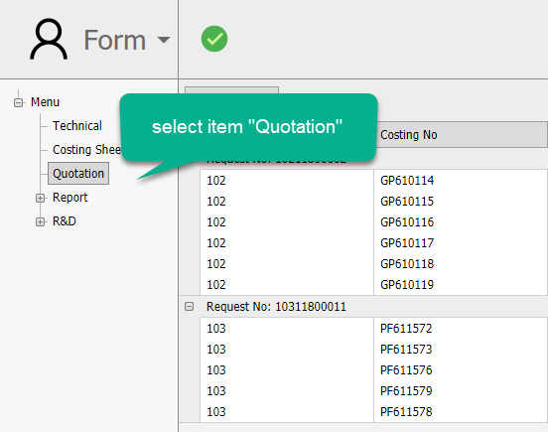
Create Quotation

Slide 17

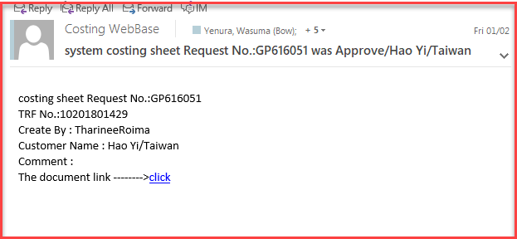
Create Quotation

Slide 18
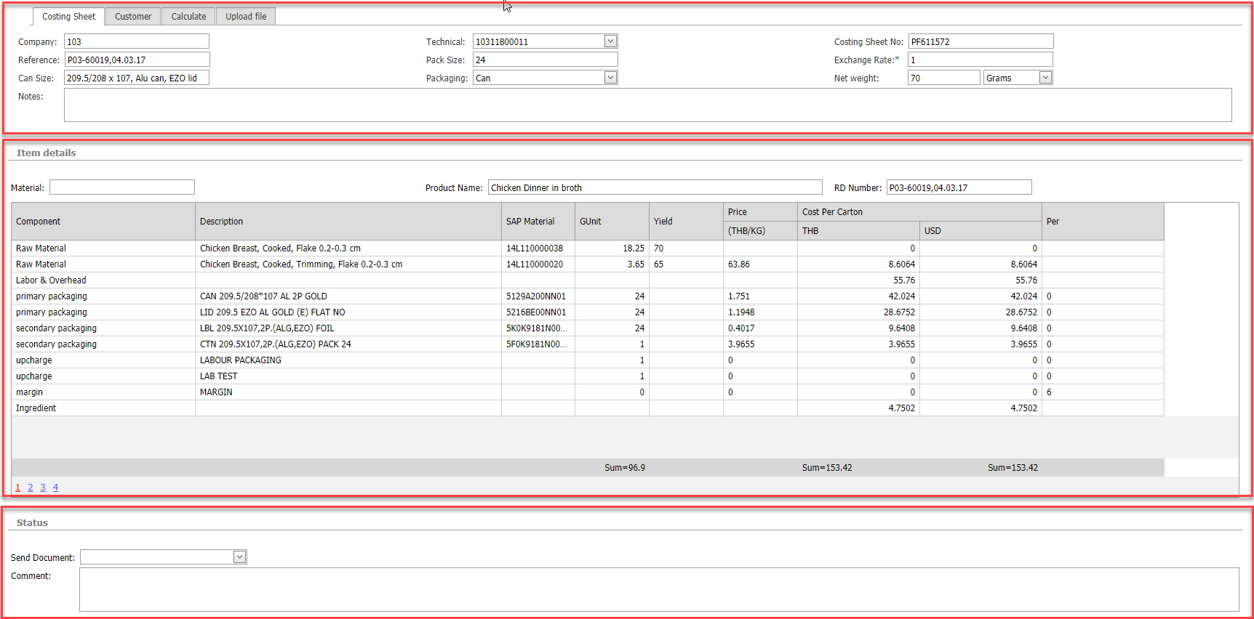
Create Quotation
Costing Details
Change exchange rate
Change margin

Slide 19

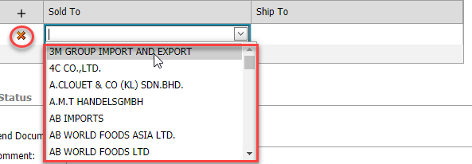

Create Quotation
Click save items

Slide 20
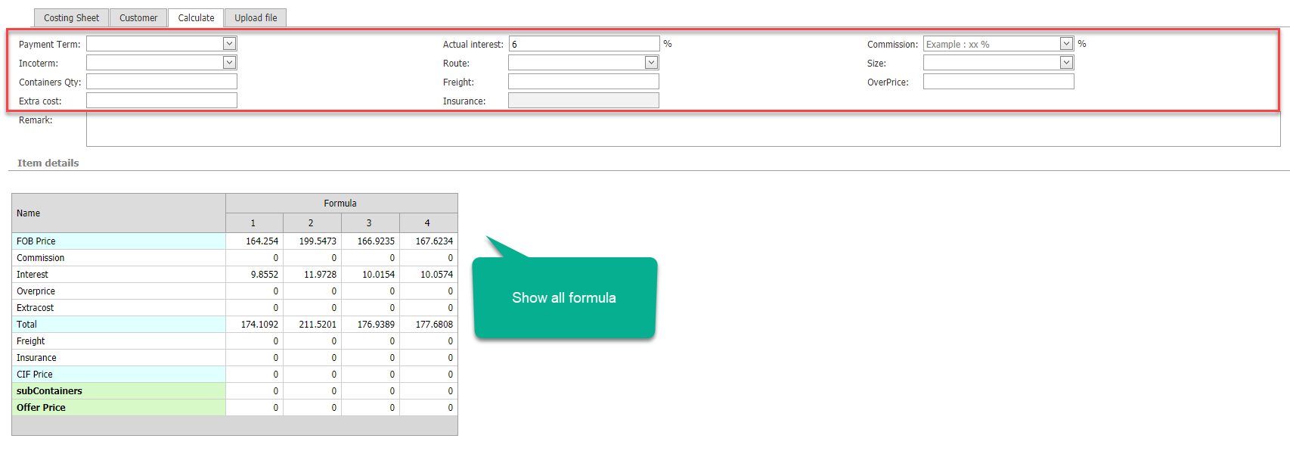
Create Quotation

Slide 21
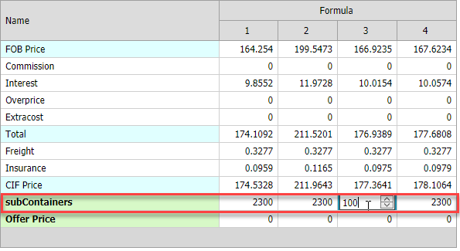
Create Quotation
Input level header
change level items by formula

Slide 22
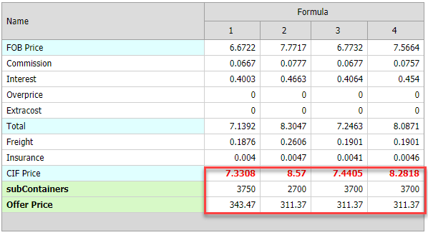
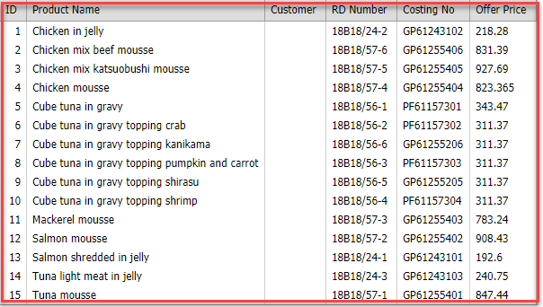
Create Quotation
Offer Price from upload file

Slide 23
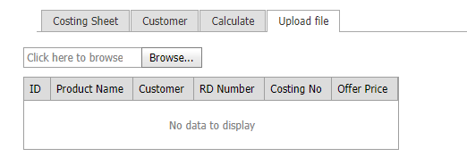
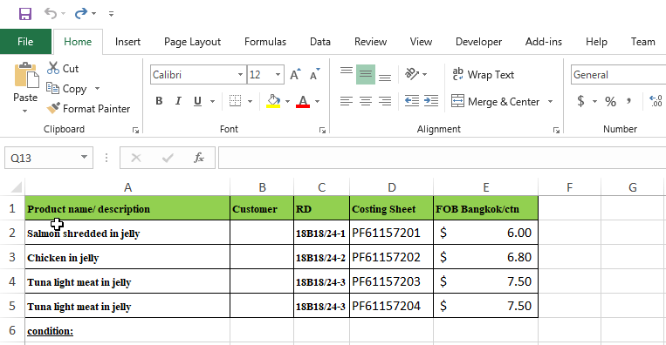
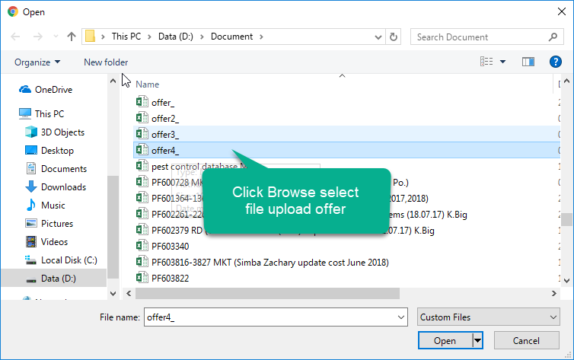
Create Quotation
Format file excel

Slide 24

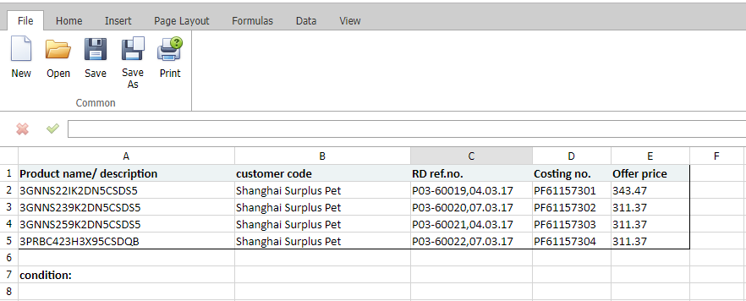
Create Quotation

Slide 25
Thank you

